Slide 1
Constituency Parsing
Natural Language Processing
(based on revision of Chris Manning Lectures)

Slide 2
Announcement
TA announcements (if any)...

Slide 3
Suggested Readings
https://web.stanford.edu/~jurafsky/slp3/12.pdf (context-free grammar)
https://web.stanford.edu/~jurafsky/slp3/13.pdf (constituency grammar)
Parsing with Compositional Vector Grammars
Constituency Parsing with a Self-Attentive Encoder

Slide 4
Recap: Context-free grammar / Constituency grammar
VP -> V PP
e.g., talk to the cat
NP -> Det N
e.g., the cat
NP -> Det (Adj) N
e.g., the large cat
S -> NP VP
e.g., the cat walked behind the dog
PP -> P NP
e.g., by the door
More grammar rules! As much as we want….
NP -> Det (Adj) N (PP)
e.g., the large cat by the door
NP -> Det (Adj)* N (PP)
e.g., the large cute furry cat by the door

Slide 5
Composition of meanings
How can we work out the meaning of larger phrases?
The snowboarder is leaping over a mogul
A person on a snowboard jumps into the air
People interpret the meaning of larger text units – entities, descriptive terms, facts, arguments, stories – by semantic composition of smaller elements

Slide 6
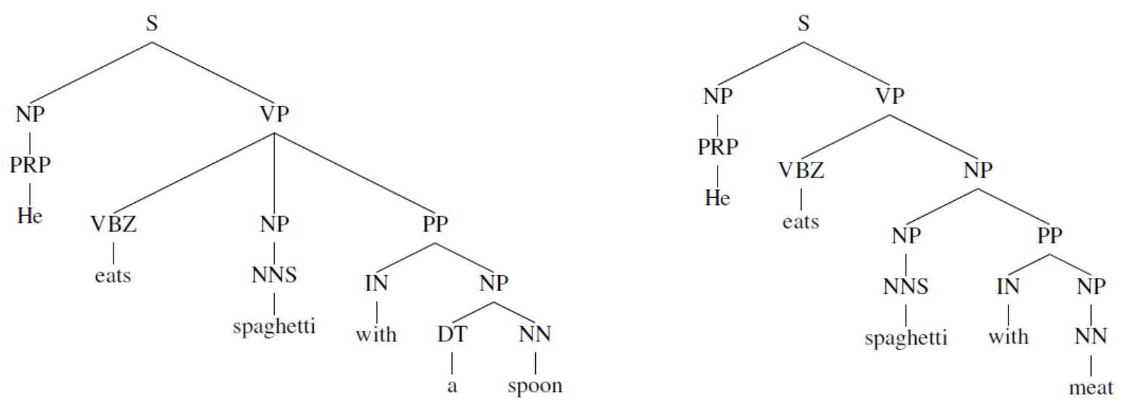
Language in recursive structure
Language can be expressed in recursive structure (i.e., context-free grammar or constituency grammar)
[The person standing next to [the man from [the company that purchased [the
firm that you used to work at]]]]

Slide 7
Version 1: Tree + NN

Slide 8
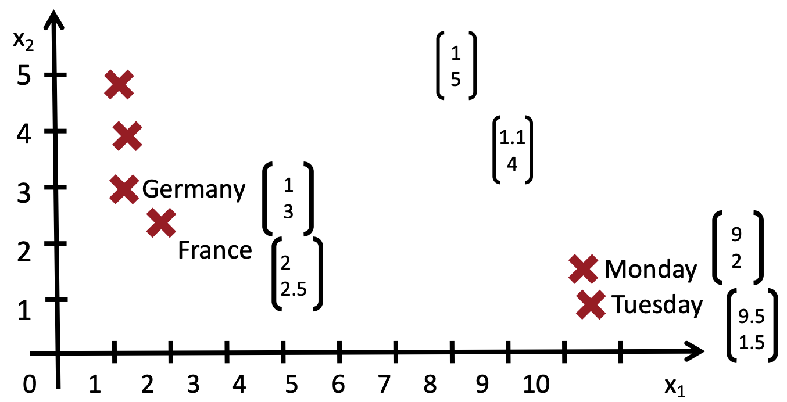
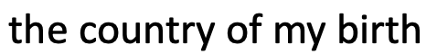

How to start now? [Socher et al., ICML 2011]
Can we get some phrase embeddings?
Parsing Natural Scenes and Natural Language with Recursive Neural Networks, Socher et al. 2011, https://www-nlp.stanford.edu/pubs/SocherLinNgManning_ICML2011.pdf

Slide 9
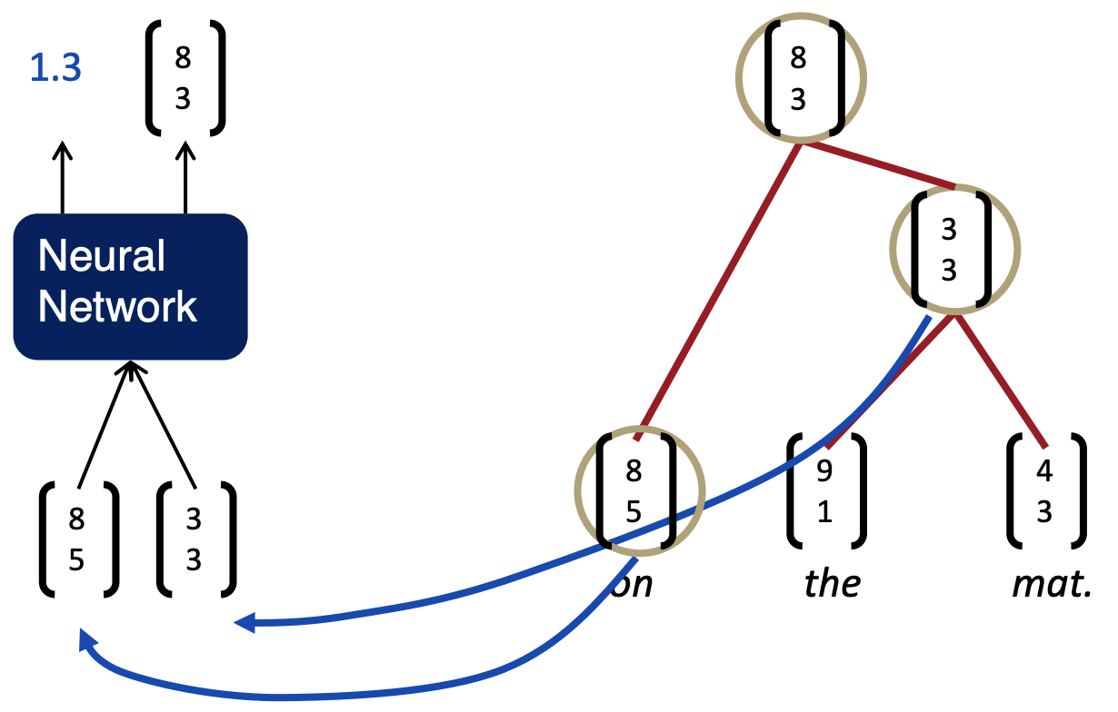
Input and output
Input: two children’s embeddings
Output: (1) composition goodness score, (2) combined embeddings

Slide 10
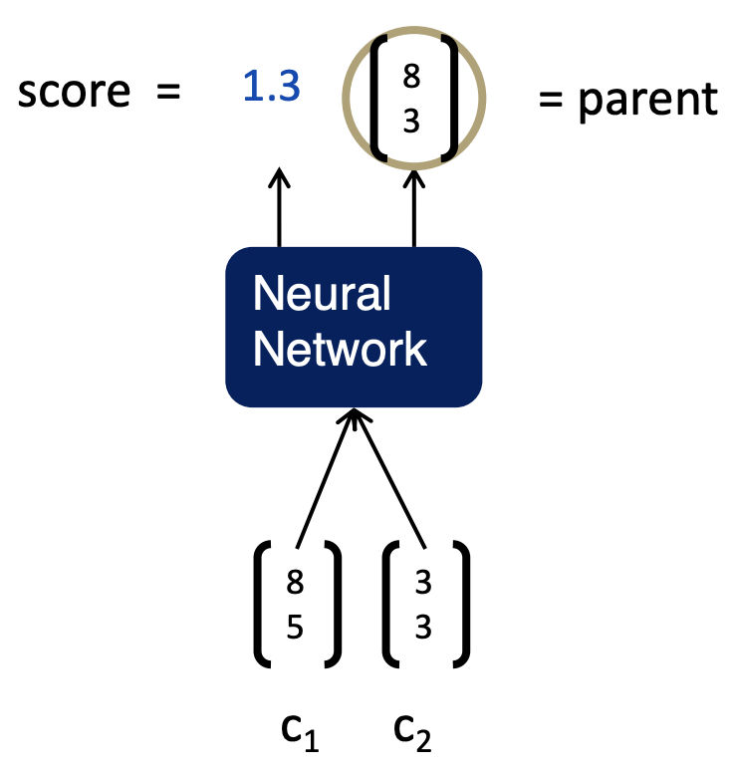

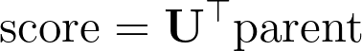
Input and output
Note: Same W is used at all nodes. [;] is concatenation

Slide 11
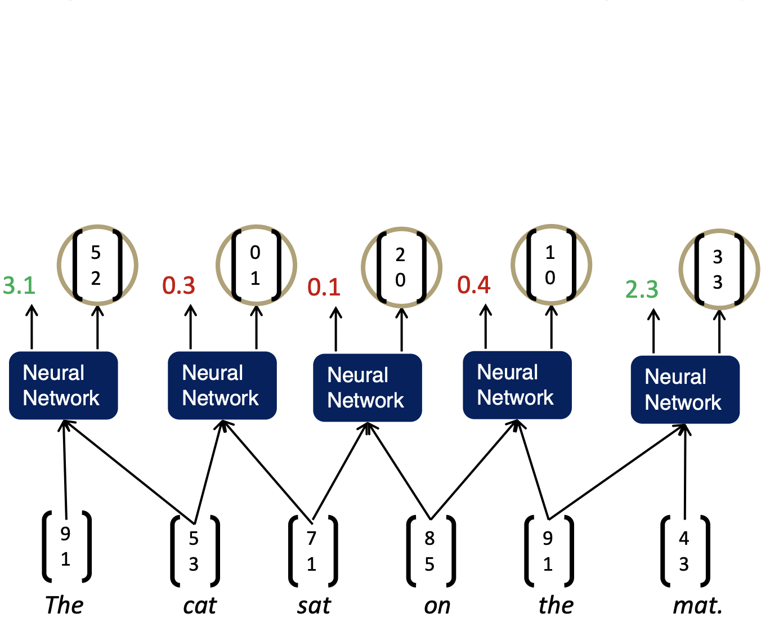
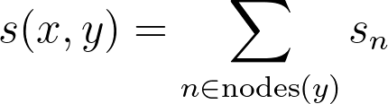
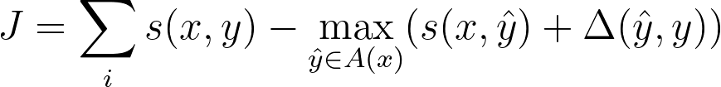
Greedy Parsing
Algorithm: Compute all contiguous pair of inputs. Choose the best score and merge. And repeat until no more nodes can be merged.
The score of a tree is computed by the sum of the parsing decision scores at each node where x is the sentence (the cat sat on the mat) and y is the result tree:
The loss is based on max-margin parsing (Taskar et al., 2004), where the loss is defined as (x is the sentence, y is the true parse tree, yhat is the best parse tree, A is the function that yields the tree, ∆ defines the margin we want to penalize for each wrong merge)

Slide 12
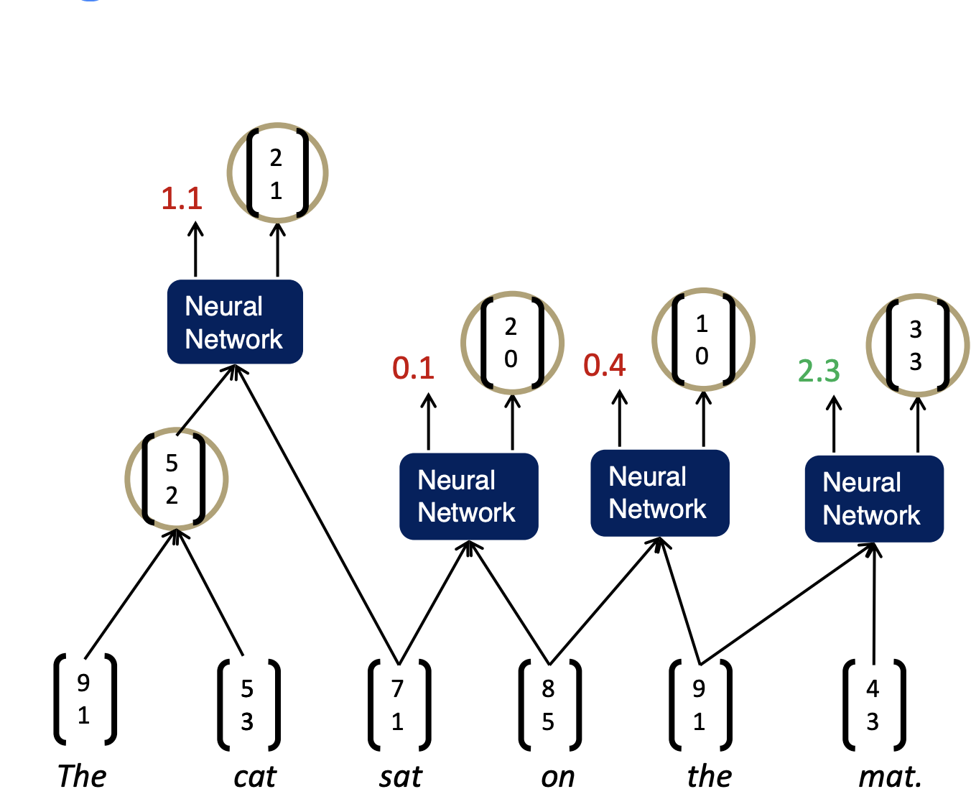
Greedy Parsing
Algorithm: Compute all contiguous pair of inputs. Choose the best score and merge. And repeat until no more nodes can be merged.
The score of a tree is computed by the sum of the parsing decision scores at each node where x is the sentence (the cat sat on the mat) and y is the result tree:
The loss is based on max-margin parsing (Taskar et al., 2004), where the loss is defined as (x is the sentence, y is the true parse tree, yhat is the best parse tree, A is the function that yields the tree, ∆ defines the margin we want to penalize for each wrong merge)

Slide 13
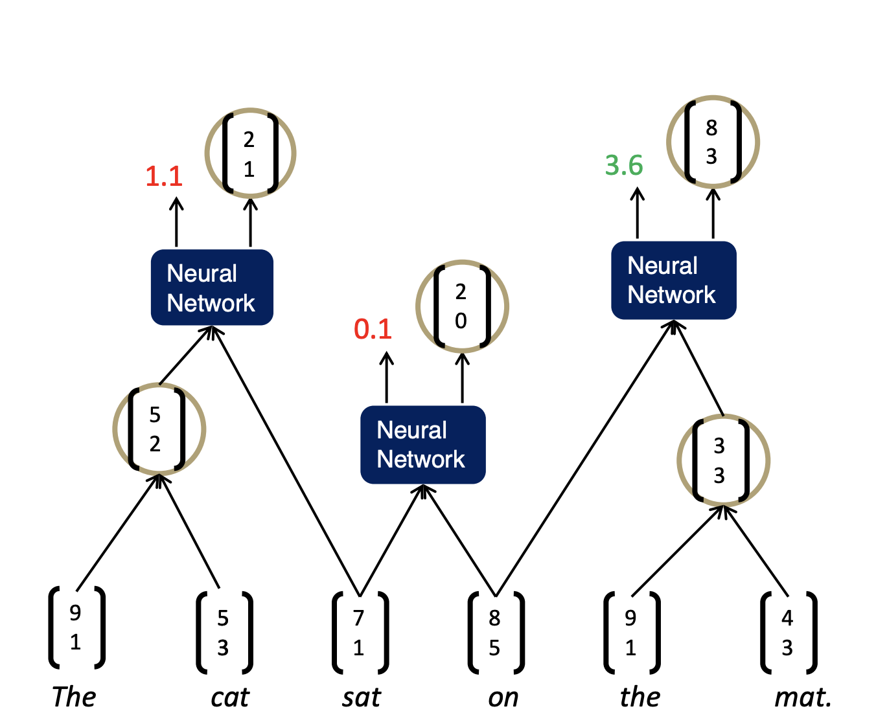
Greedy Parsing
Algorithm: Compute all contiguous pair of inputs. Choose the best score and merge. And repeat until no more nodes can be merged.
The score of a tree is computed by the sum of the parsing decision scores at each node where x is the sentence (the cat sat on the mat) and y is the result tree:
The loss is based on max-margin parsing (Taskar et al., 2004), where the loss is defined as (x is the sentence, y is the true parse tree, yhat is the best parse tree, A is the function that yields the tree, ∆ defines the margin we want to penalize for each wrong merge)

Slide 14
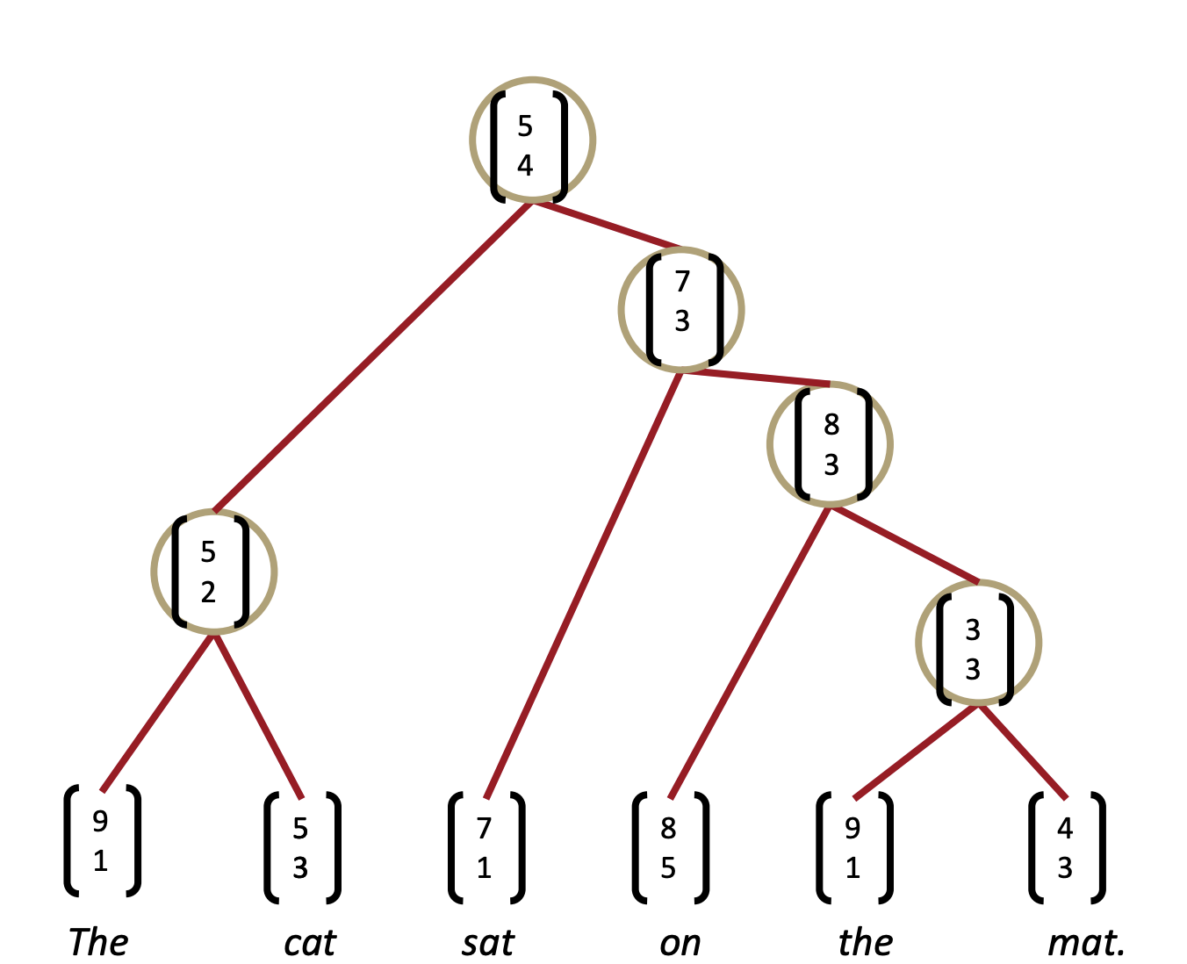
Greedy Parsing
Algorithm: Compute all contiguous pair of inputs. Choose the best score and merge. And repeat until no more nodes can be merged.
The score of a tree is computed by the sum of the parsing decision scores at each node where x is the sentence (the cat sat on the mat) and y is the result tree:
The loss is based on max-margin parsing (Taskar et al., 2004), where the loss is defined as (x is the sentence, y is the true parse tree, yhat is the best parse tree, A is the function that yields the tree, ∆ defines the margin we want to penalize for each wrong merge)

Slide 15
Discussion
Potential limitations
Single weight matrix could NOT capture more complex, higher order composition and parsing long sentences
E.g., different semantics between
det + noun (e.g., the cat). Here the activation should be higher for “cat”, i.e., the second word
np + cc (e.g., cat and). Here the activation should be higher for “cat”, i.e., the first word
Addressed in version 2
No interactions between input words
Simple concatenation assumes no interaction. Does not work for some cases, e.g., “very good”; here “very” amplifies “good”, or “should have been good”; here “should have been” negates “good”
Addressed in version 3

Slide 16
Version 2: Multiple W + Tree + RNN

Slide 17
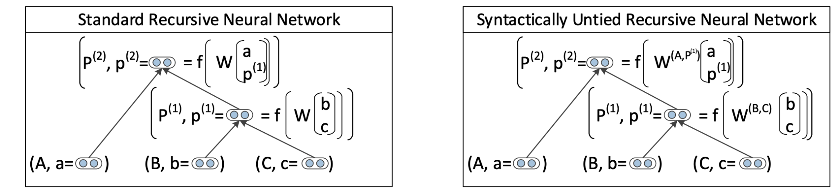
Multiple W + Tree + RNN [Socher et al., ACL 2013]
Idea: simply assign a different matrix for every combinations!
Problem: speed
Solution: calculate score only for some very likely combination…..also use some shared W for very similar compositions
Parsing with compositional vector grammars, Socher et al. 2013, https://aclanthology.org/P13-1045.pdf

Slide 18
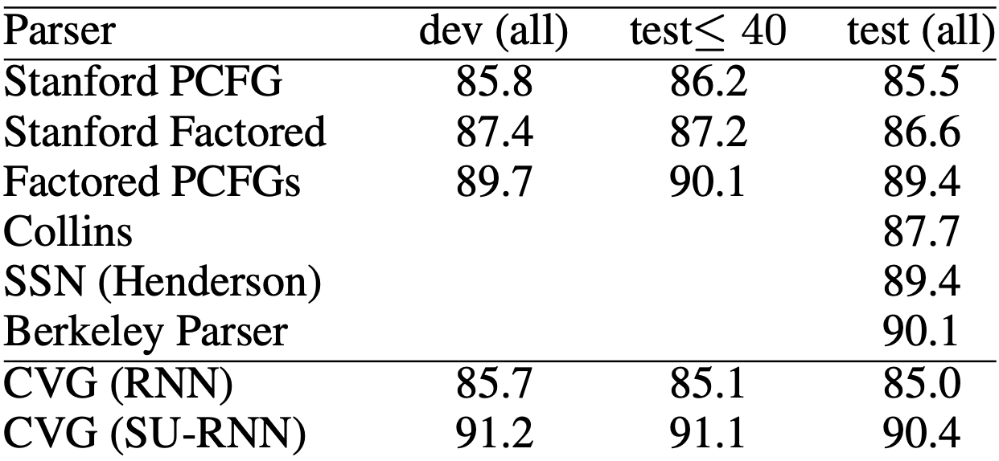
Multiple W + Tree + RNN
SU-RNN (multiple W matrix) seems to outperform other manually featured parser at that time.

Slide 19
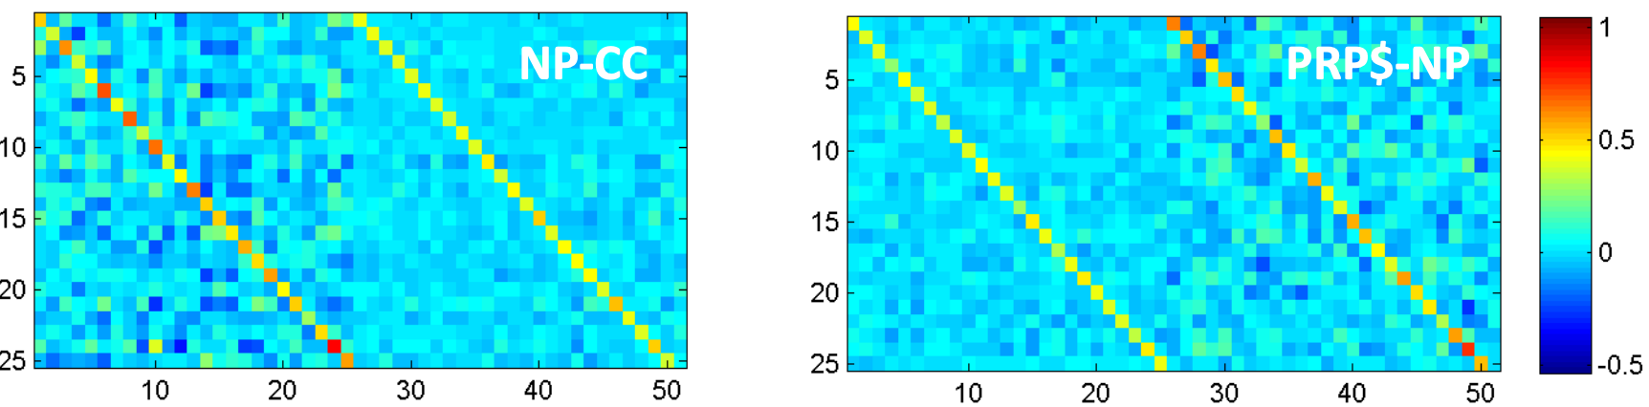
Multiple W + Tree + RNN
Different W seems to be able to activate differently based on the composition
e.g., the cat and
e.g., at the door

Slide 20
Discussion
Potential limitations
Speed remains a bit problem of this approach
Again, no interactions between input words

Slide 21
Version 3: Matrix-Vector + Tree + RNN

Slide 22
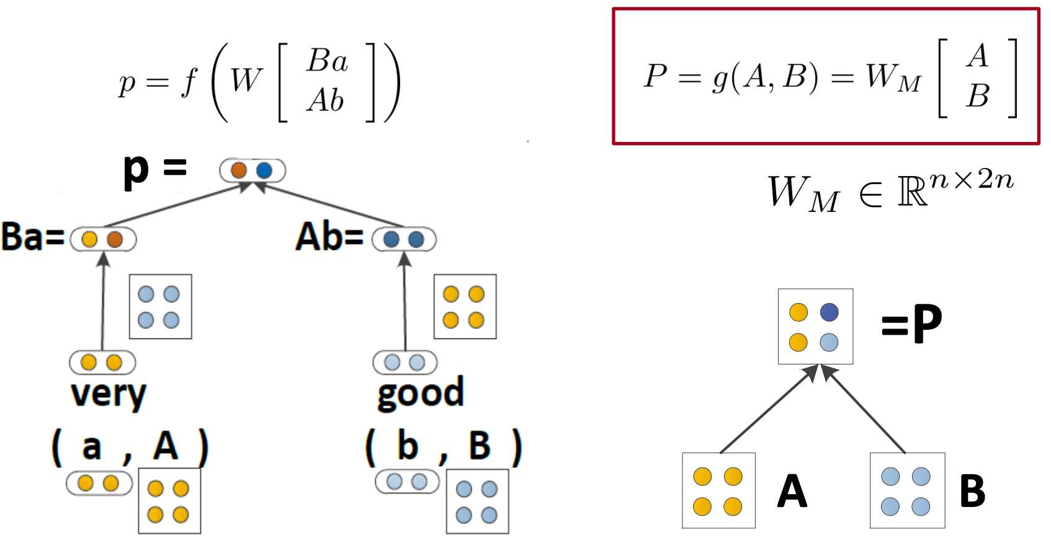
Matrix-Vector + Tree + RNN [Socher et al., EMNLP 2012]
Semantic Compositionality through Recursive Matrix-Vector Spaces, Socher et al. 2012, https://dl.acm.org/doi/pdf/10.5555/2390948.2391084

Slide 23
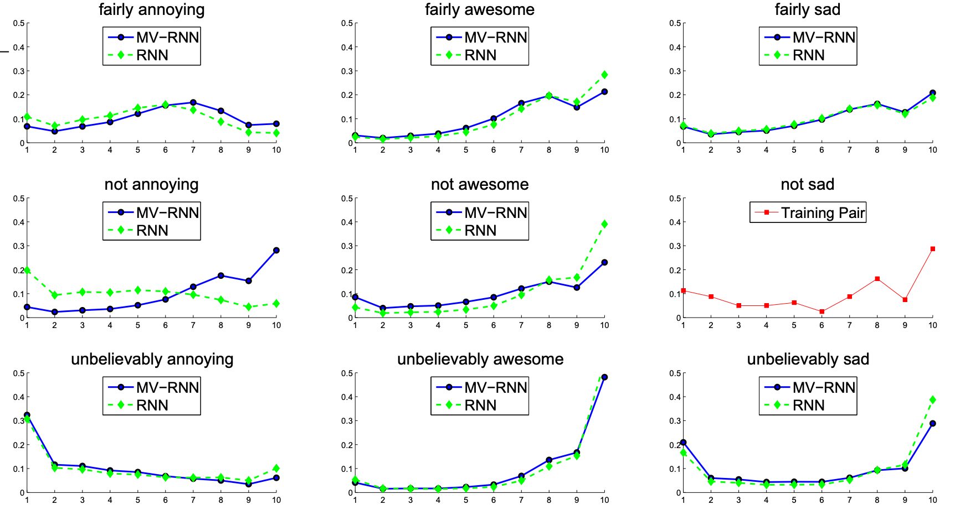
Matrix-Vector + Tree + RNN
x-axis is the prediction (10 is very positive); y-axis is the probability distribution. For “not annoying”, notice MV-RNN was able to predict 10 with relatively higher probability, while RNN predict a much lower probability for 10.

Slide 24
A little bit of sentiment analysis
Is the piece of text positive, negative, or neutral?
Sentiment is “easy”, especially for very long documents ~90%
….loved…..great……impressed…..marvelous
However, if the model “memorizes”, it will not be able to predict this kind of sentence correctly:
“The movie should have been better and more entertaining.”

Slide 25
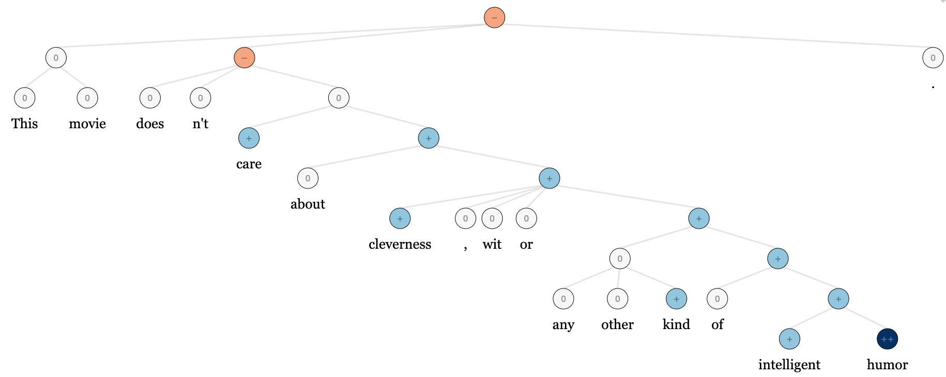
Stanford Sentiment Treebank
215,154 phrases (not sentences!) labeled in 11,855 sentences
Can actually help train and test compositions
http://nlp.stanford.edu:8080/sentiment

Slide 26
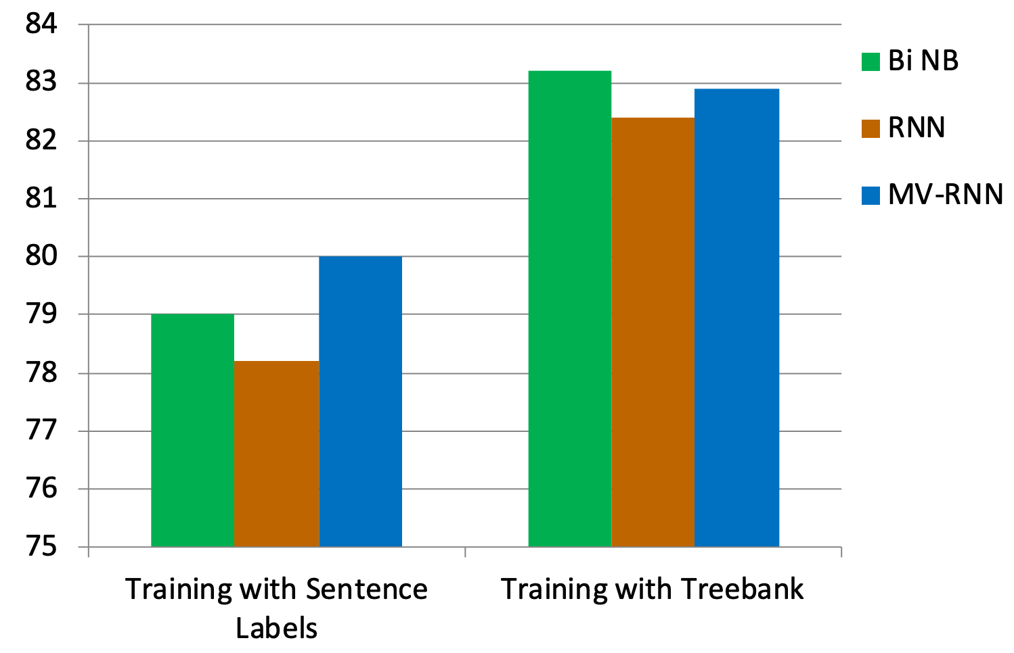
Better dataset helped all models

Slide 27
Discussion
Potential limitations
Every word comes with an extra matrix….

Slide 28
Version 4: Tensor + Tree + RNN

Slide 29
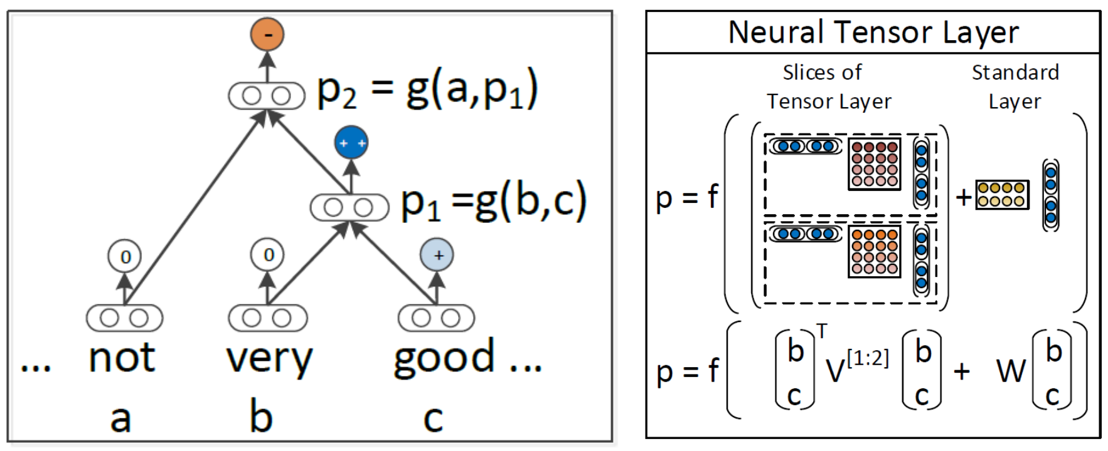
Tensor + Tree + RNN [Socher et al., EMNLP 2013]
Less parameters than MV-RNN
Allows the two word or phrase vectors to interact via multiplication through a middle tensor (3-dimensional) matrix
-For each slice
(1 x 4) @ (4 x 4) @ (4 x 1) = (1, 1)
- By having two slices of V, where this number “two” is simply the dimension of the word embedding, we will get a two-dimensional vector. Then we just add with another transformed concatenated vectors (i.e., W([b;c]))
Recursive Deep Models for Semantic Compositionality Over a Sentiment Treebank, Socher et al. 2013, https://aclanthology.org/D13-1170.pdf

Slide 30
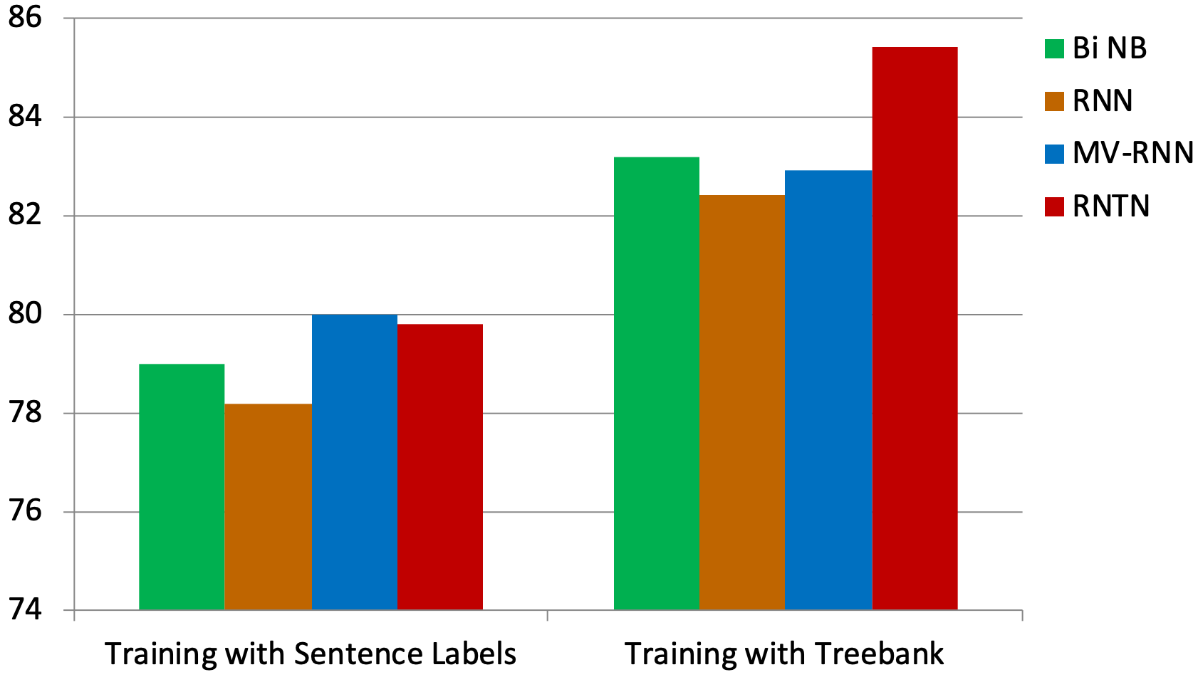
Accuracy improves to 85.4

Slide 31
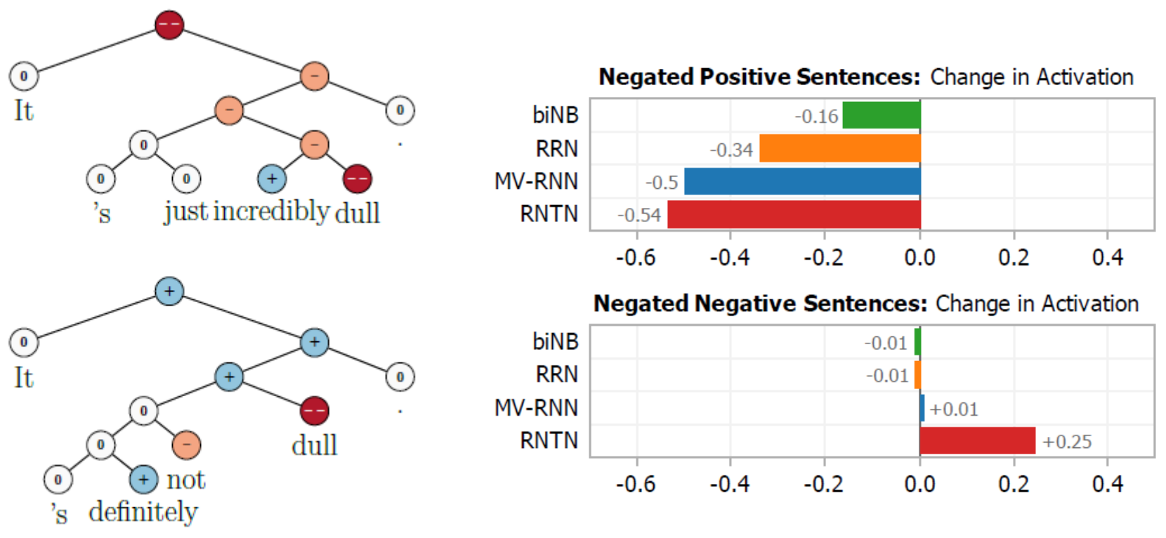
Negating negatives should increase positive activation

Slide 32
Takeaways
Potential limitations
Cannot think of one at that time…..(maybe plug more powerful model than RNN?)
Many work follows, e.g., using LSTM instead (Tai et al., ACL 2015)
Sentiment analysis or sentence classification is hard once you make it a very short sentence!
Nowadays, not many works utilized such tree-based approach. Many possible reasons:
Due to the tree structure, does not allow GPU to work efficiently, because the operations are not uniform
Many other models can well capture compositionality, especially CNN (bigrams, trigrams, etc.) or even attention (all possible grams!)
No one uses anymore does not mean we should not study. At least, we learn the “underlying” philosophy how researchers think which is even more important!
Nevertheless, such tree-based method can be very useful for something like program translation (Chen et al., NeuroIPS 2018) when the language is very structured, unlike natural language.
Improved Semantic Representations From Tree-Structured Long Short-Term Memory Networks, Tai et al., 2015, https://dl.acm.org/doi/pdf/10.5555/2390948.2391084
Tree-to-tree Neural Networks for Program Translation, Chen et al. 2018, https://papers.nips.cc/paper/2018/file/d759175de8ea5b1d9a2660e45554894f-Paper.pdf

